Slide 1
[ Exhibitor Guide ]
HOW TO UPLOAD
POSTERS & VIDEOS

Slide 2
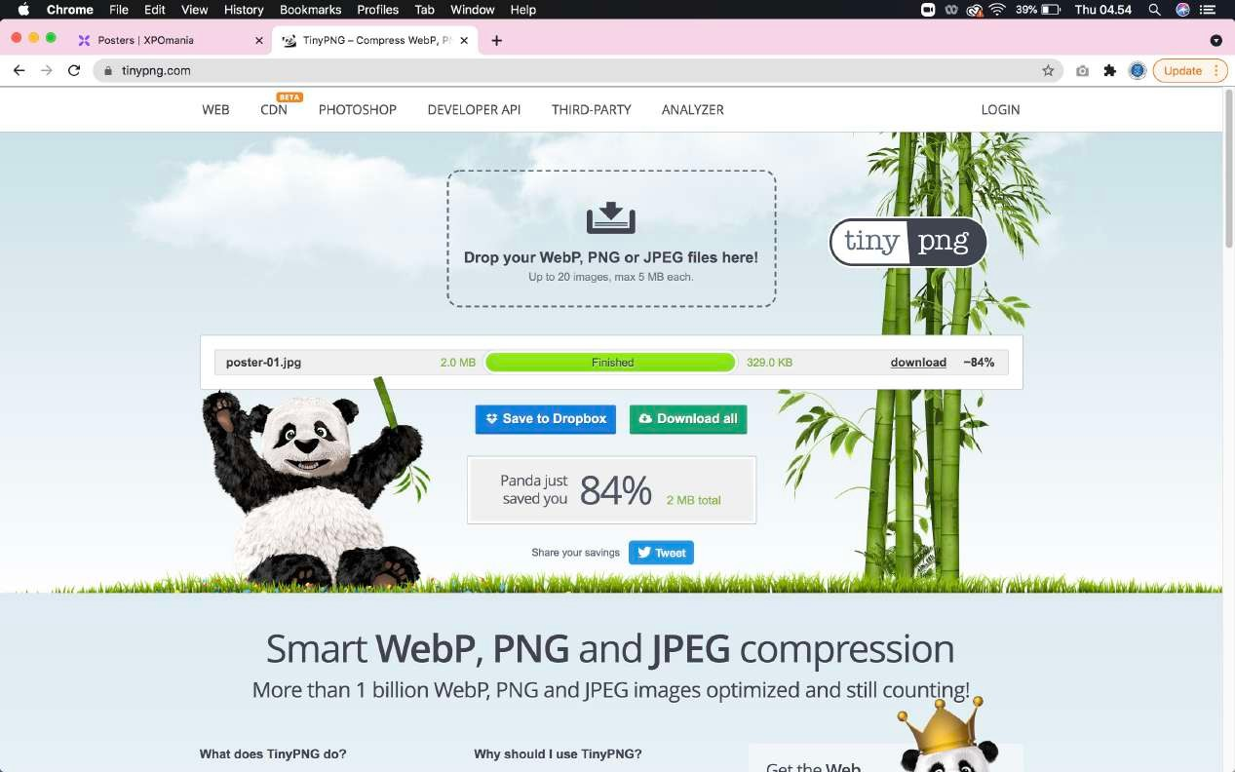
01
Prepare your poster and video files in advance. It is highly recommended to compress your poster file so that the file size becomes smaller using the following online tools: https://tinypng.com/
Compress Poster

Slide 3
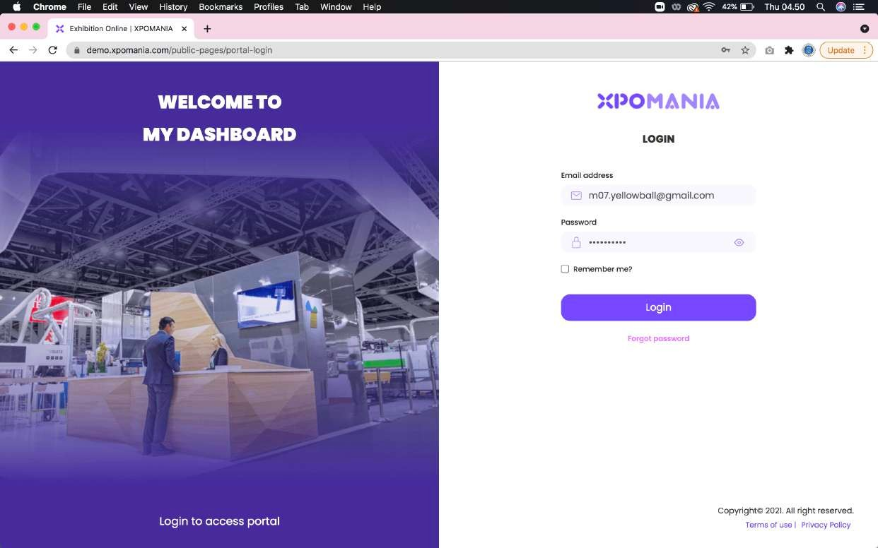
02
Please login via XPOMANIA Portal / Dashboard using the email and password sent to the registered email.
Portal Login

Slide 4
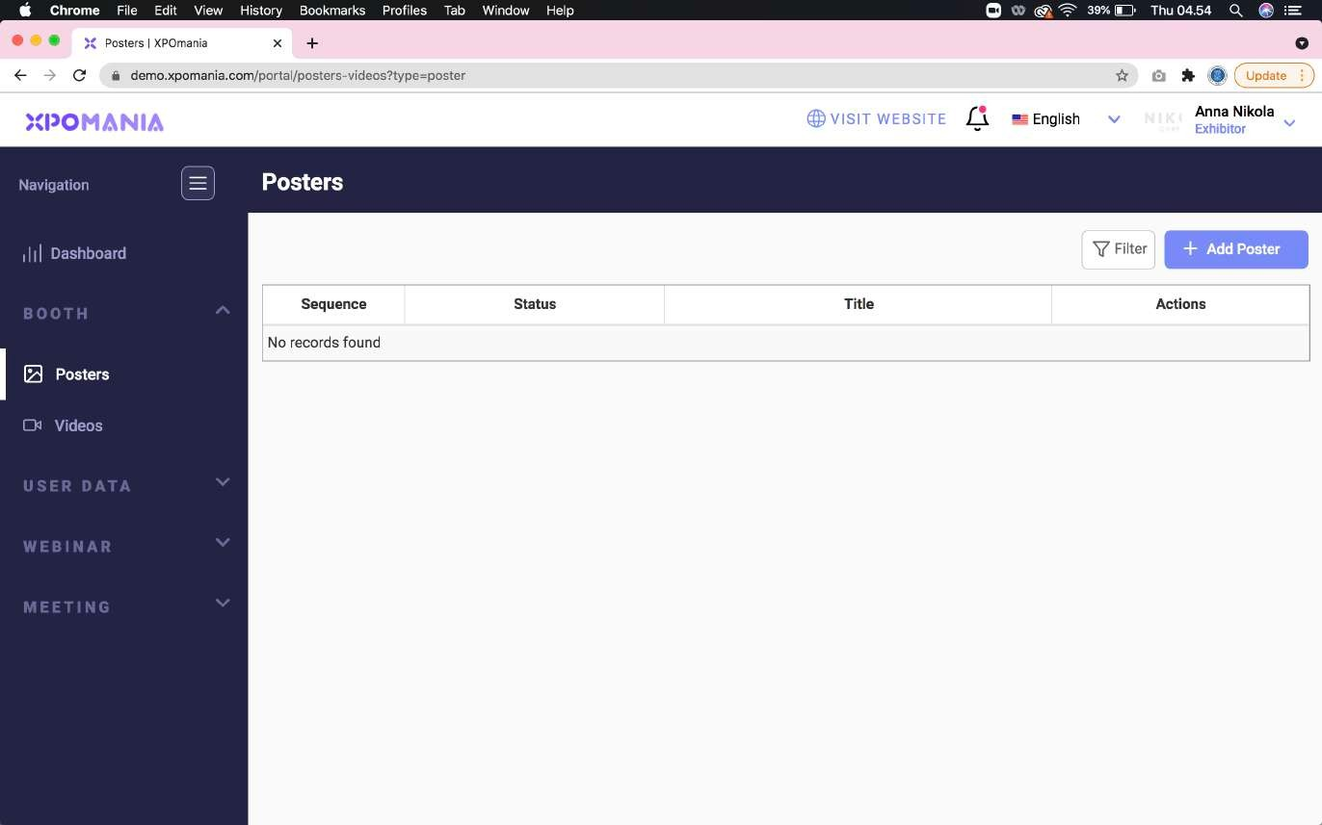
03
After successfully logging in, please select the “Posters” menu then click the “Add Poster” but- ton. This section serves to fill the Poster Wall on your booth so it doesn’t look empty/black.
Add Poster

Slide 5
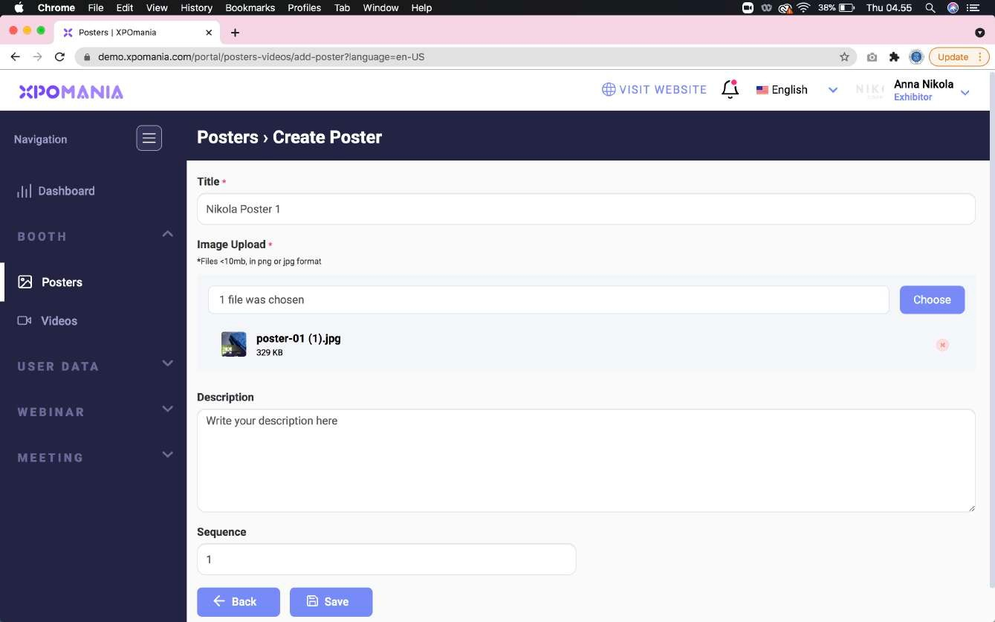
04
Please upload the compressed poster file by clicking the “Choose” button and fill in the poster title according to the poster content. When finished, please click the “Save” button.
Upload Poster

Slide 6
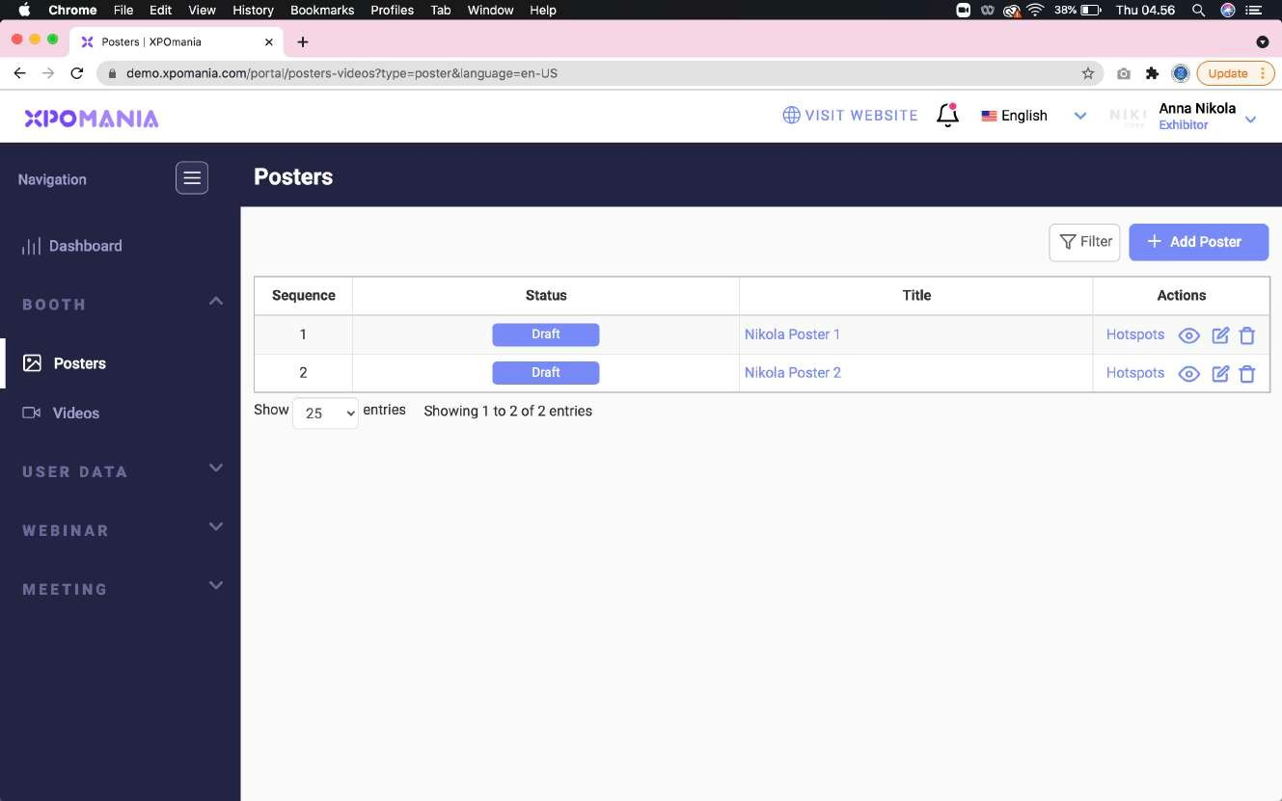
05
Repeat the same steps for uploading the 2nd poster. You will see that both of your posters are still in “Draft” status. The Event Organizer will change the status of your poster to “Approved” if it is judged to meet the standards and rules imposed by the EO.
Status Poster

Slide 7
06
Don’t forget to fill your poster’s “Hotspot” with the same poster file. By clicking “Hotspots” and then uploading your poster in the same way as before. In “Hotspot” you can upload more than 1 poster/image (maximum 3 poster/image).
Hotspot Poster Menu

Slide 8
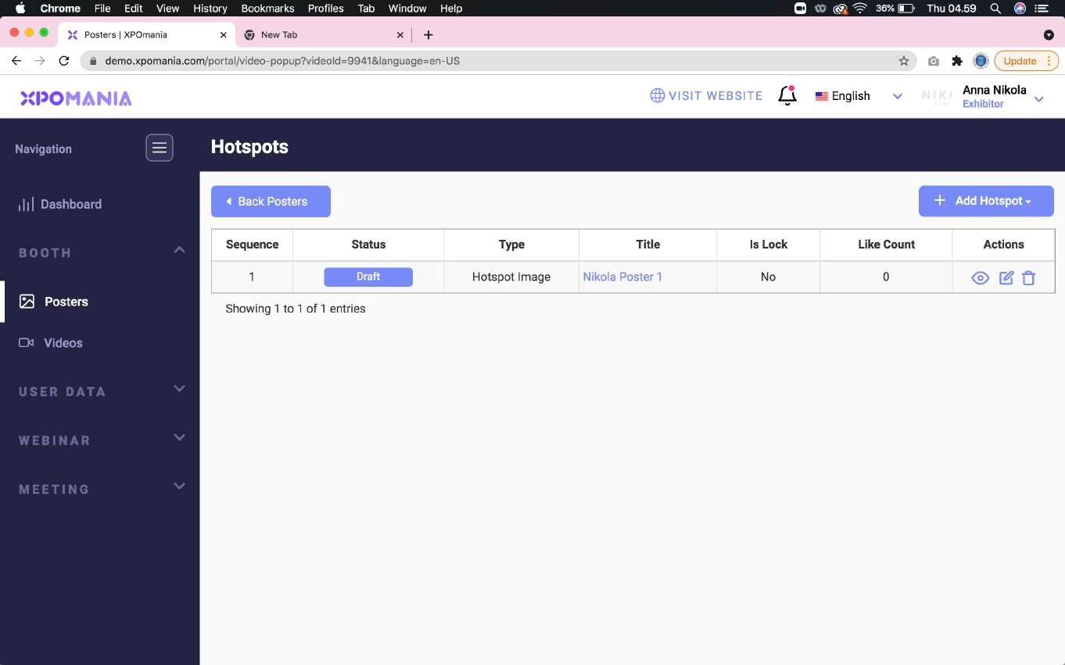
07
Here’s what the hotspots poster looks like. This section serves to display the poster in the form of a pop up page on the website when the Poster Wall on the booth is clicked by booth visitors.
Add New Hotspot

Slide 9
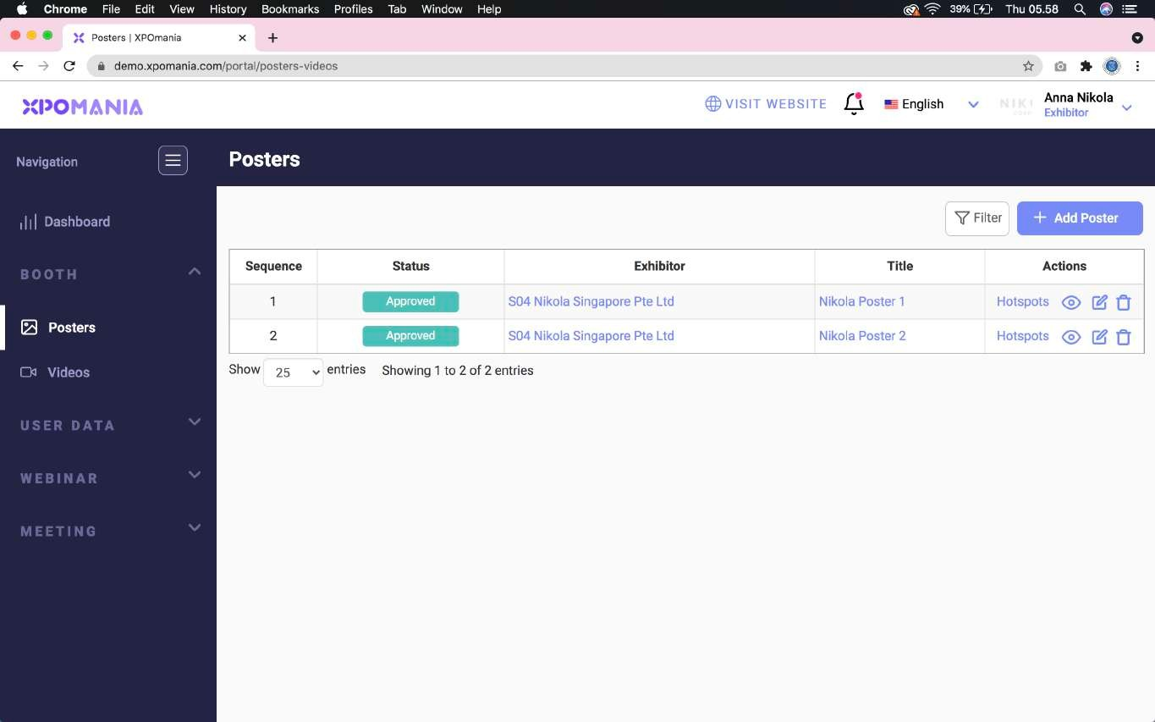
08
You will see the status “Approved” on both of your posters if the EO has approved the poster you have submitted.
Status Approved

Slide 10
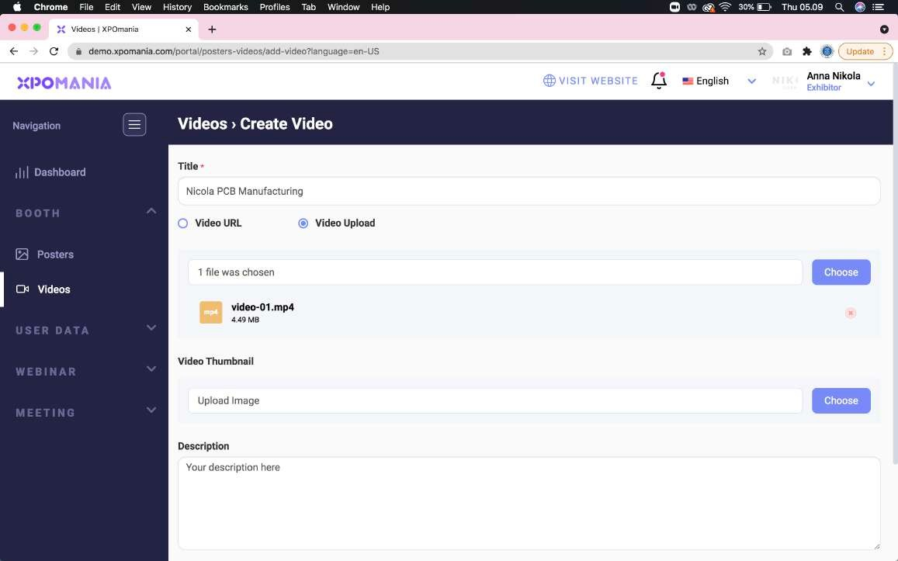
09
To upload video files, please select the “Videos” menu on the left menu. Make sure your video file is no more than 5MB. You can trim your video with a duration of 10 seconds. Because this section only serves to fill the Video Wall display on your booth. So there is no need to upload a long video duration. ATTENTION: YouTube URLs are not recommended for filling out this section. Longer versions of videos can be uploaded in the “Hotspot” section and can use YouTube URLs.
Video Upload

Slide 11
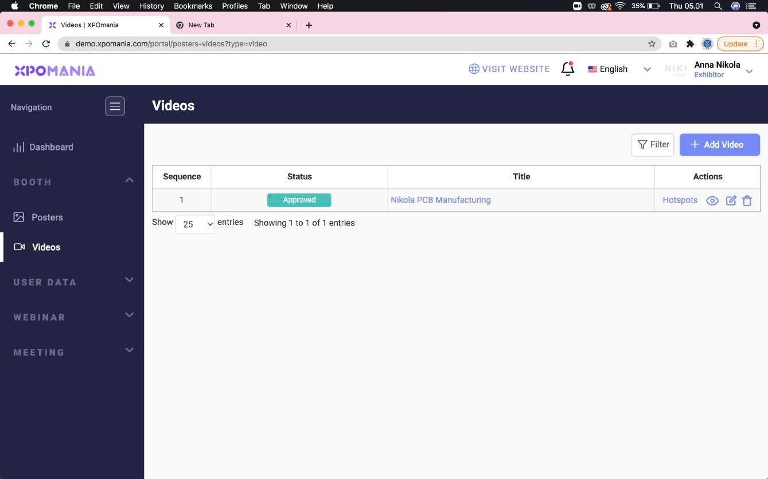
10
Just like the poster, don’t forget to fill in the “Hotspots” of the video in the same way. You will see an “Approved” status if the video has been approved by the EO.
Status Approved

Slide 12
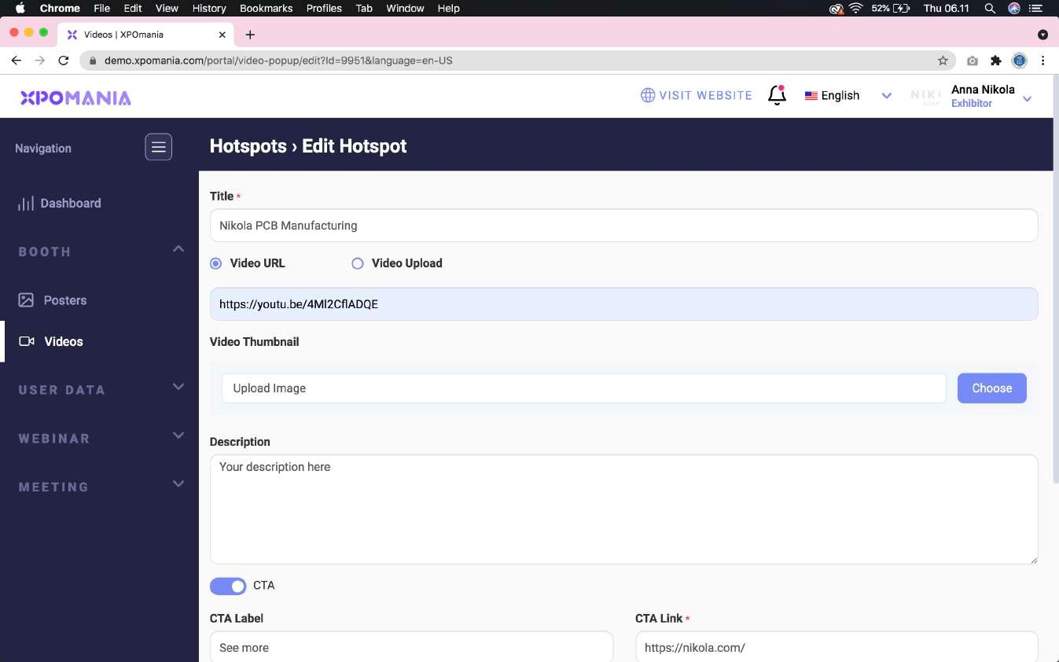
11
Longer versions of videos can be uploaded in the “Hotspot” section and can use YouTube URLs. You may enter more than 1 YouTube URL in the hotspot (maximum 3 YouTube URLs) if required.
Video Hotspot

Slide 13
12
You can also use the CTA button using an external URL link such as your online shop: Official Website, Grab Food, Tokopedia, Shopee, Blibli, etc.
CTA button & URL link

Slide 14
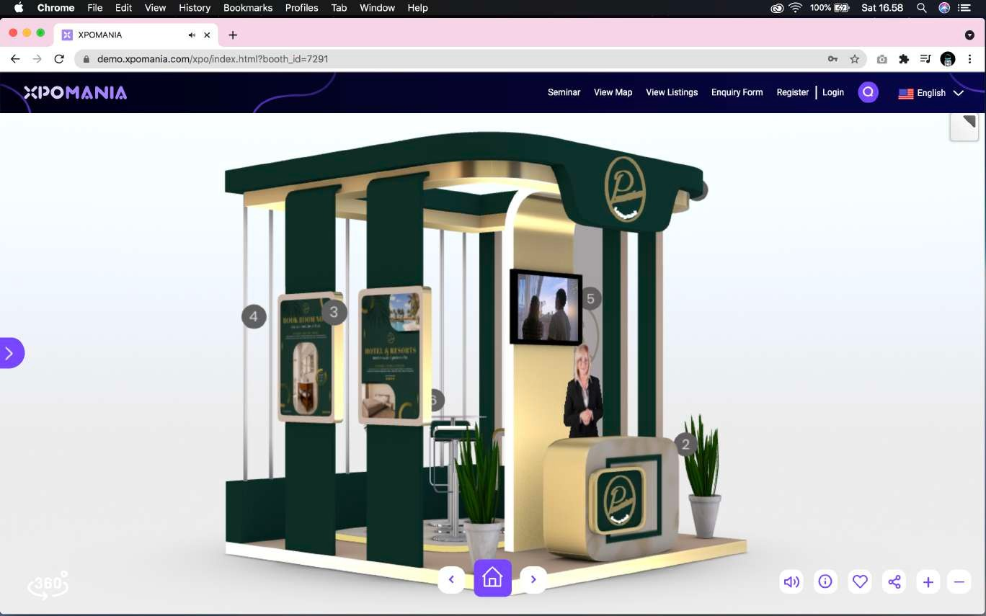
13
If the posters and videos have been successfully filled out, then the Poster Wall and Video Wall display on your booth will automatically look good too.
Display Video Wall and Poster Wall Booth Display

Slide 15
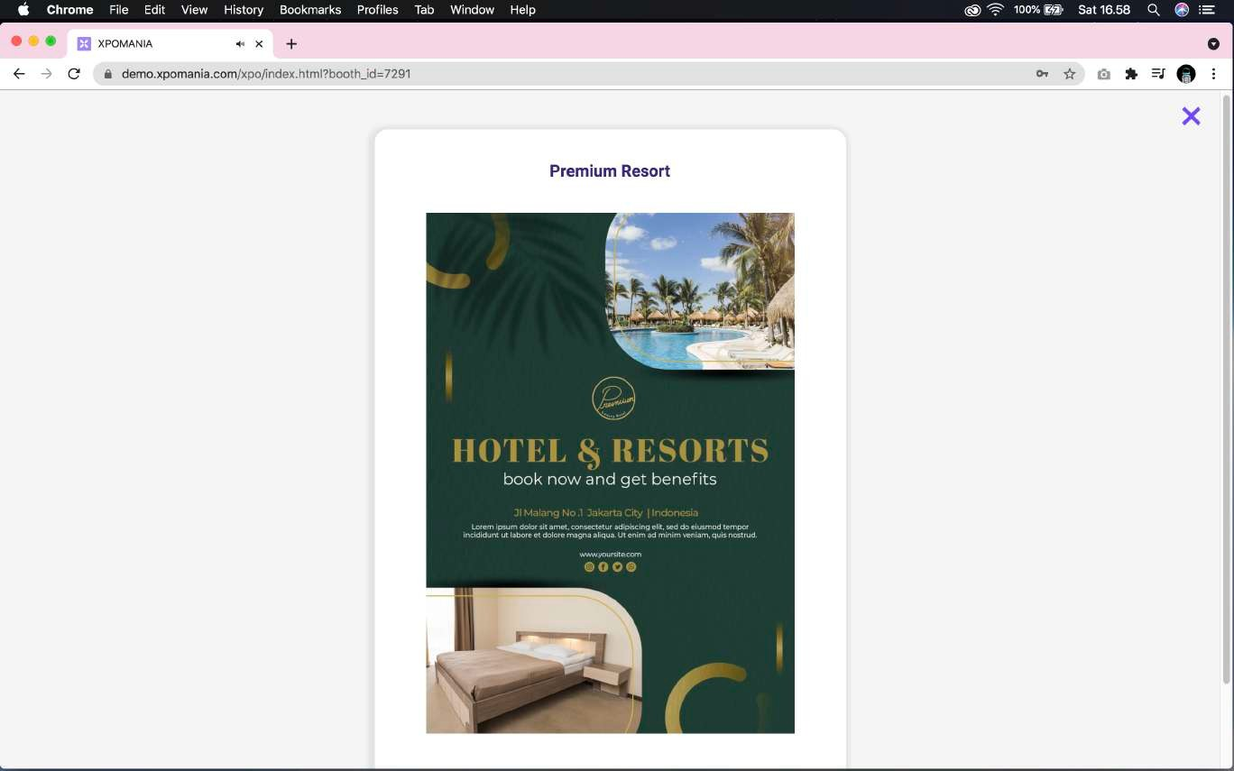
14
If the posters and videos on the Hotspot have been successfully filled in properly, then the Hotspot Poster and Video Hotspot display on your booth will automatically look good too.
Poster Hotspot Display

