Slide 1
Job Fair
VISITOR GUIDE
&Entrepreneur
expo 2021

Slide 2
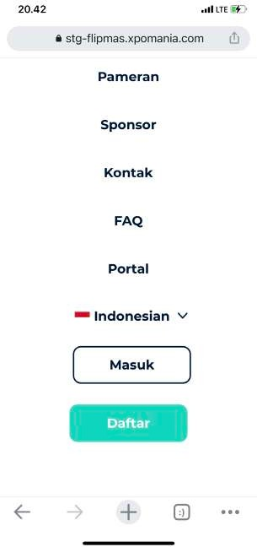
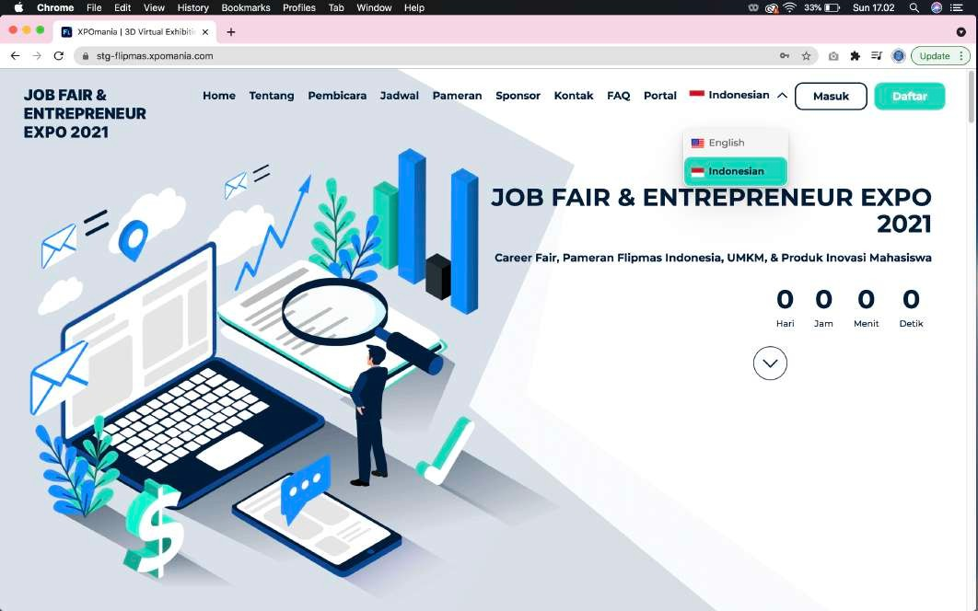
01
Exhibition visitors can choose the language "Indonesia" or "English" according to the needs of visitors to the exhibition.
Mobile - Language Choice
Desktop - Language Choice

Slide 3
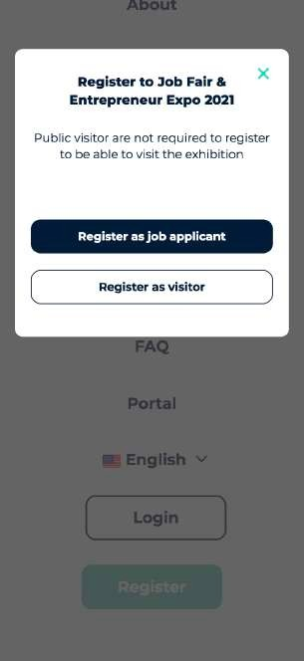
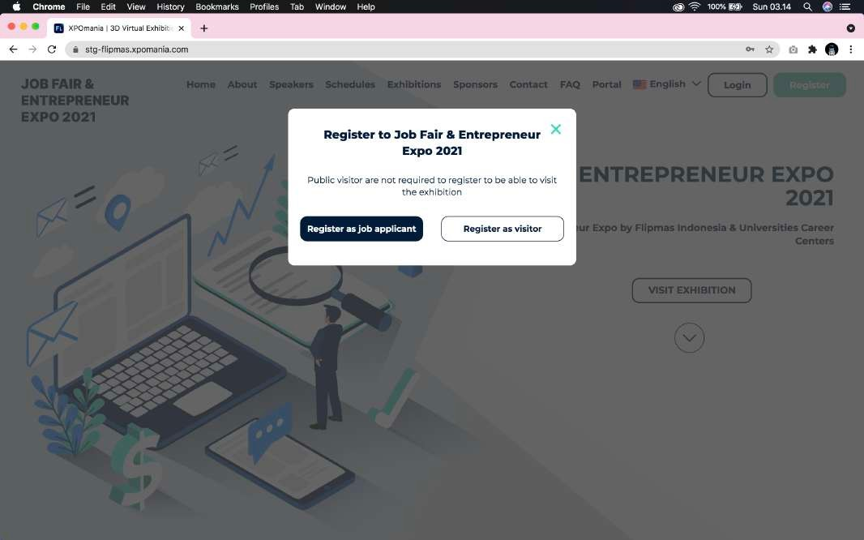
Although it is not mandatory, job applicants are also given the option of being able to register up front before entering the virtual exhibition which is required if you want to send your CV through the company booth. Take the time to fill out the registration form properly.
02
User Registration
User Registration

Slide 4
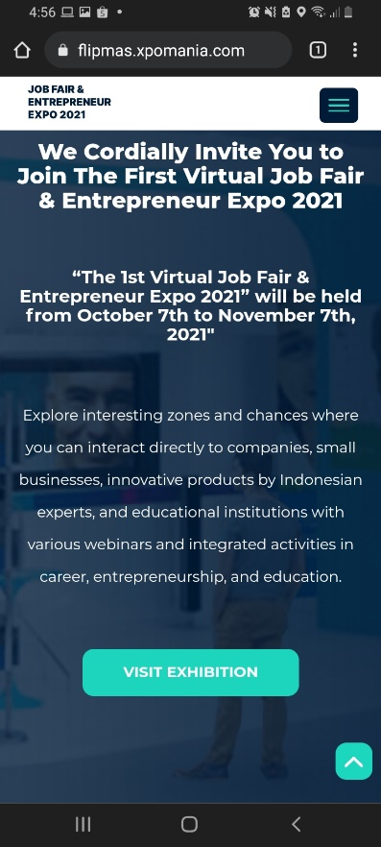
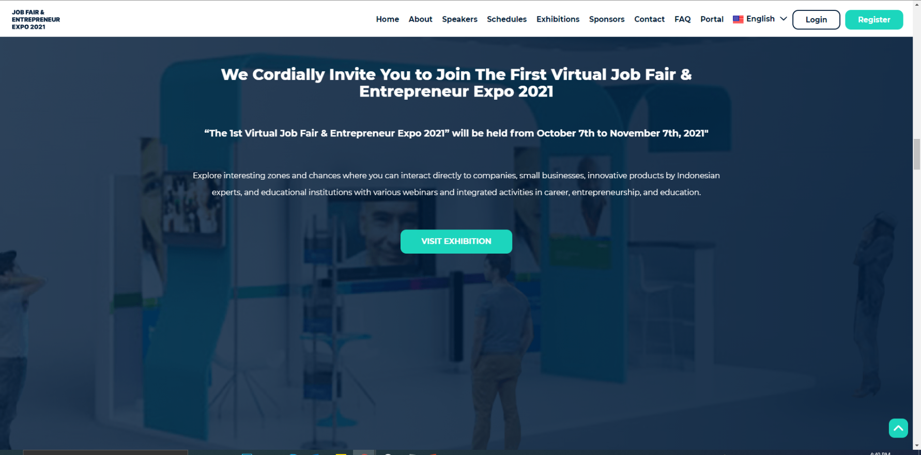
In this Virtual Exhibition, visitors are not required to register in advance. So that visitors can directly visit the virtual exhibition by clicking the button “Visit Exhibition”
03
Mobile – Visit Exhibition
Desktop – Visit Exhibition

Slide 5
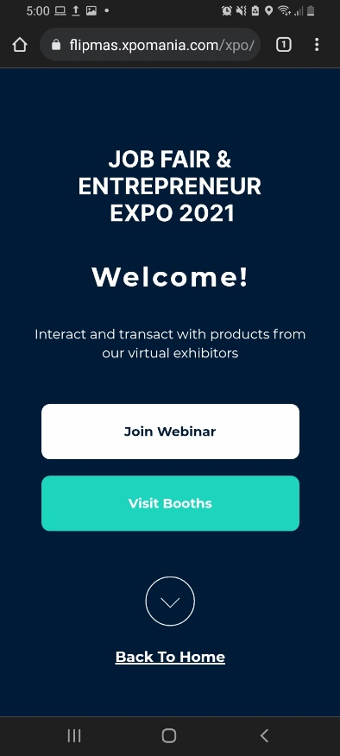
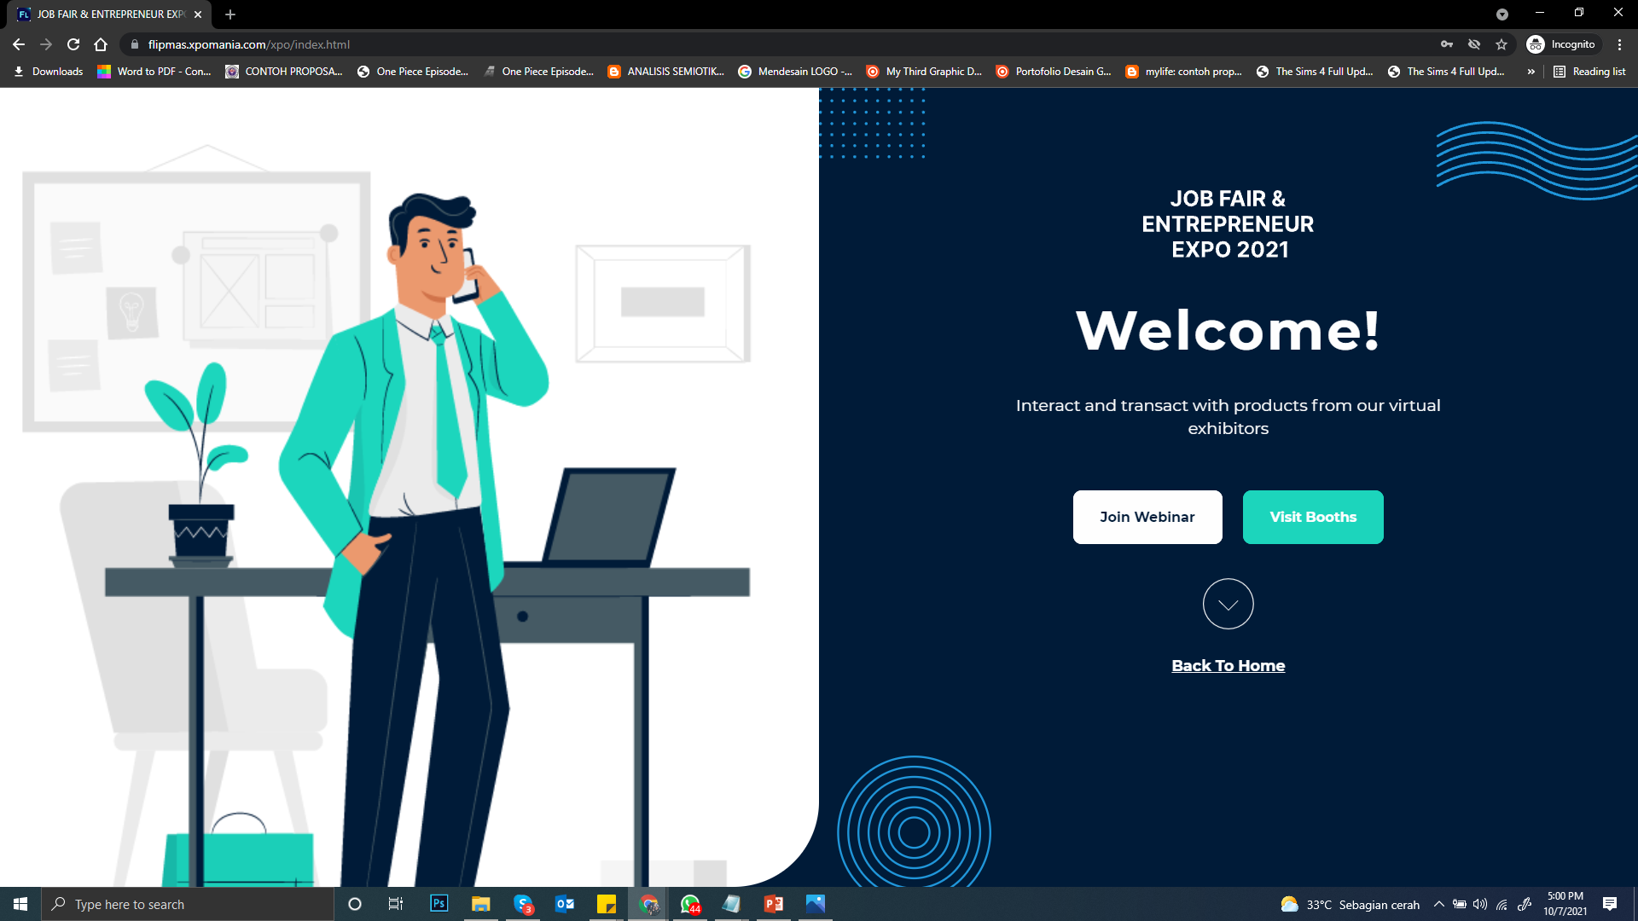
On the Welcome page, exhibition visitors can choose to participate in a live webinar by clicking “Join the Webinar” or directly visiting a virtual exhibition by clicking the “Visit Exhibition” button.
04
Mobile – Exhibition Layout (Map)
Desktop – Exhibition Layout (Map)

Slide 6
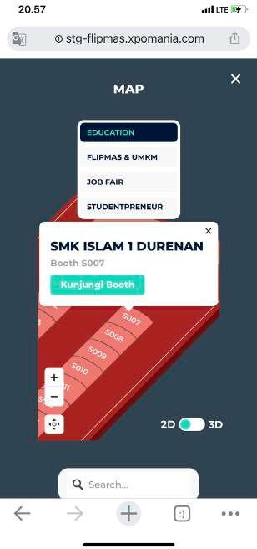
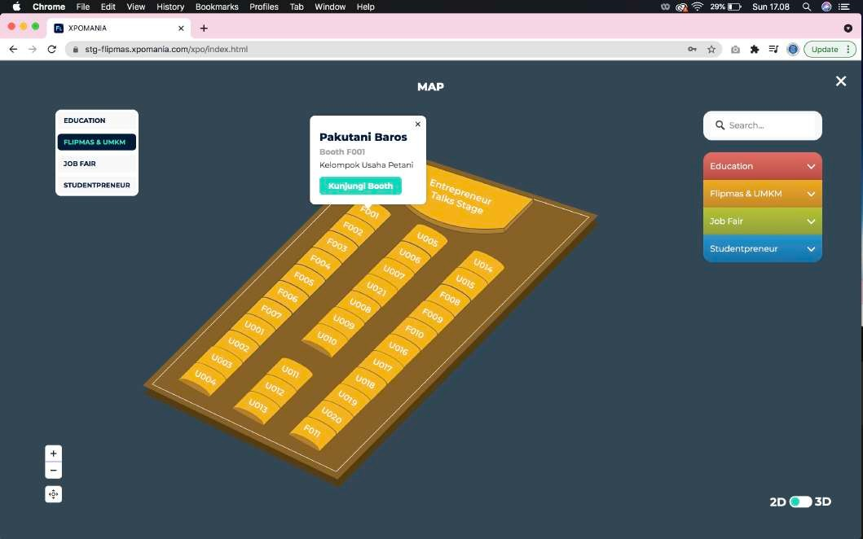
Exhibition visitors can visit the booth via the following 2D & 3D map by taking advantage of the booth search feature by zone and clicking the button
05
Mobile – Exhibition Layout (Map)
Desktop – Exhibition Layout (Map)

Slide 7
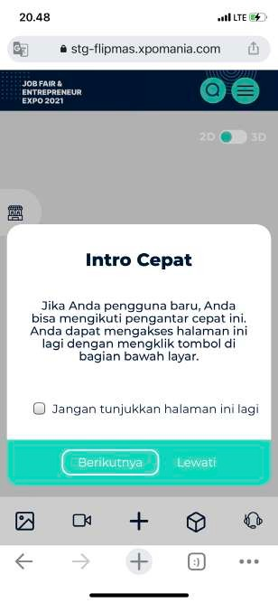
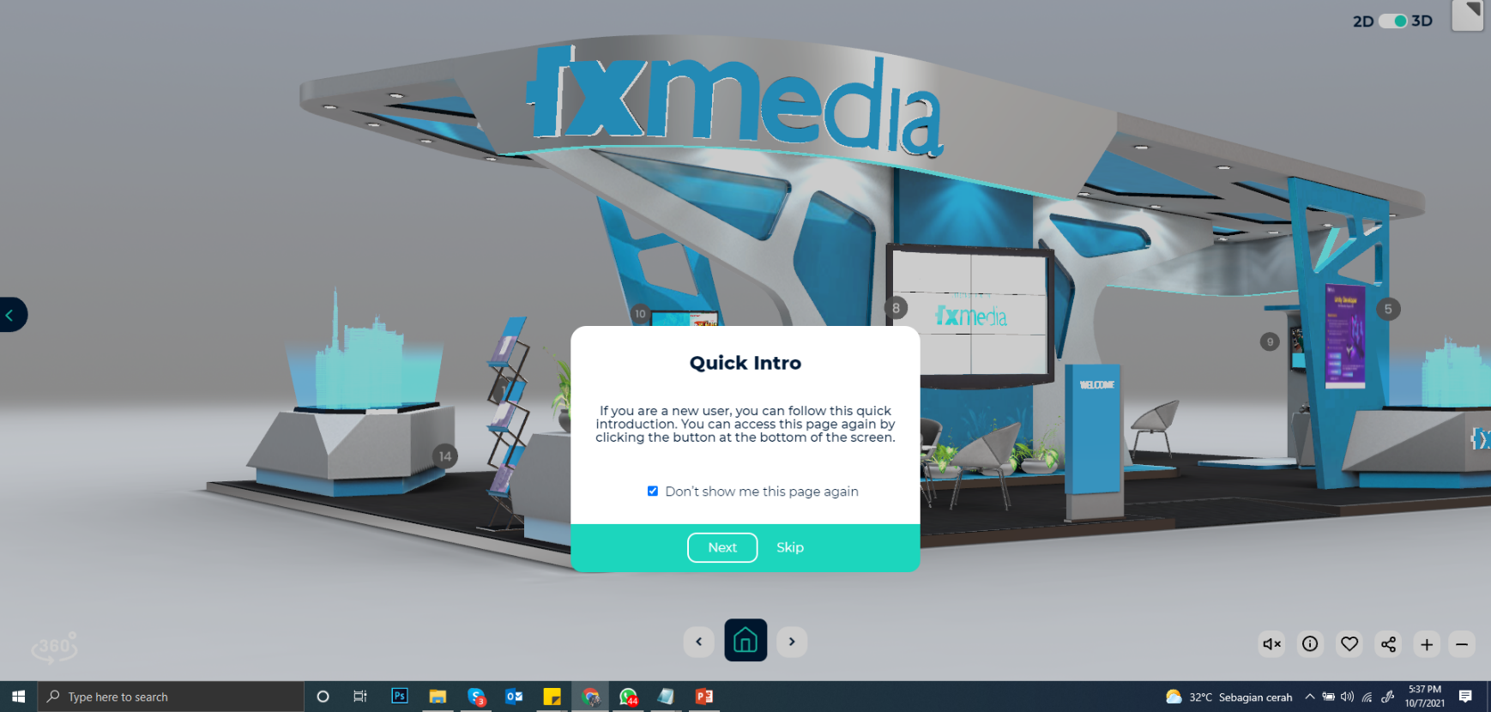
Visitors can learn quick info on how to use the features in the booth navigation area by reading “Quick Intro” or pressing the button to bring up “Quick Intro”.
06
Mobile – Quick Intro
Desktop – Quick Intro

Slide 8
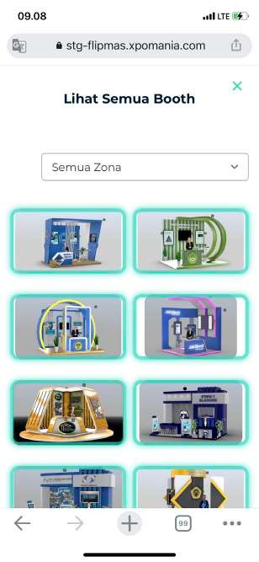
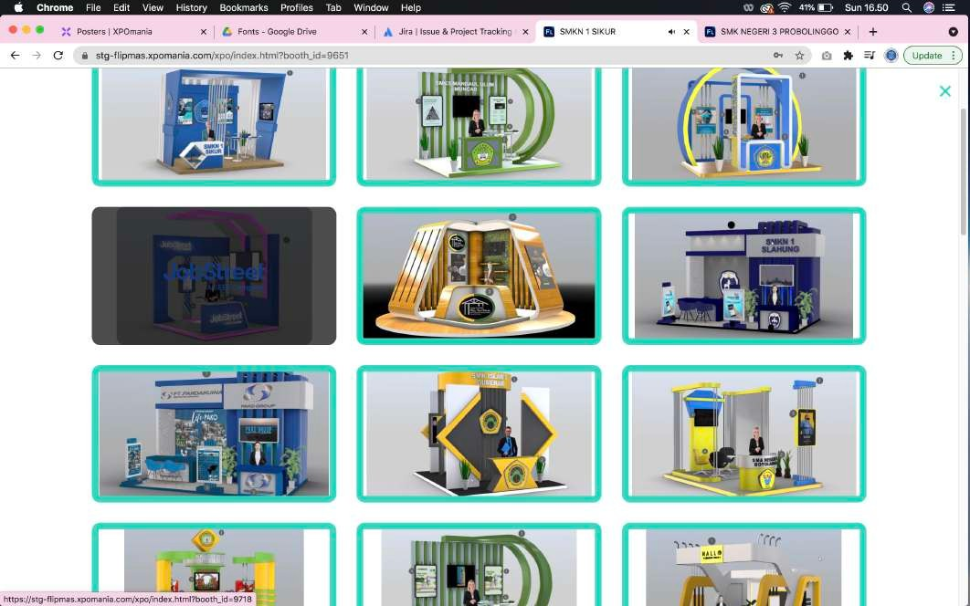
In addition to using a map, exhibition visitors can view all booth listings by zone by clicking the menu located on the main menu header.
07
Mobile – Listings Booth
Desktop – Listings Booth

Slide 9
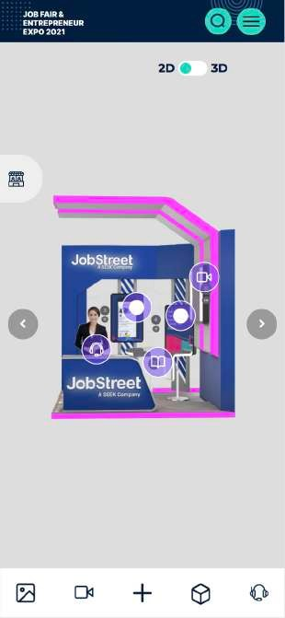
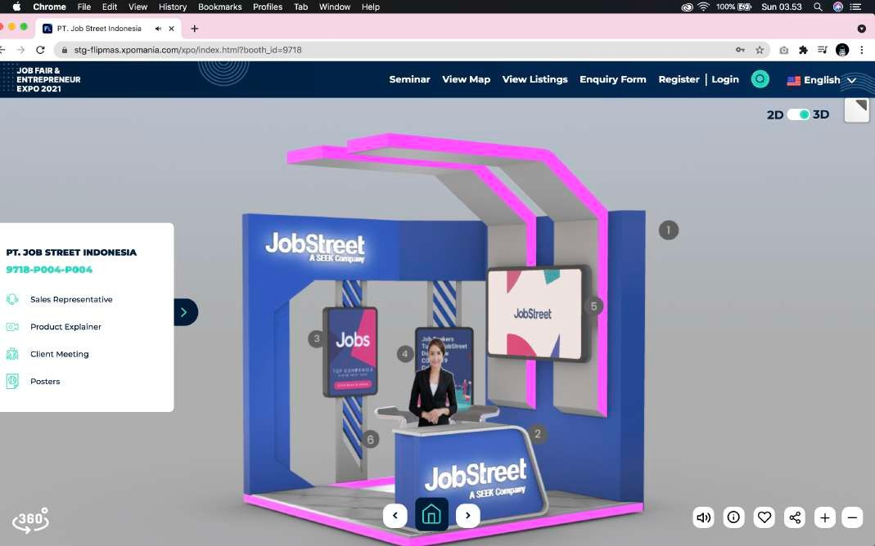
You can easily select 2D and 3D booth modes using the buttons. ATTENTION: Loading the 3D booth depends on the specs of the device you are using and the speed and stability of the internet provider network when accessing.
08
Mobile - 2D booth mode
Desktop - 3D booth mode

Slide 10
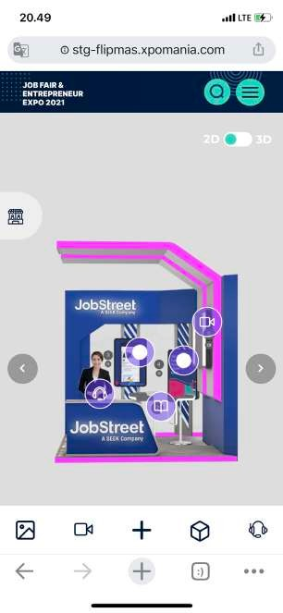
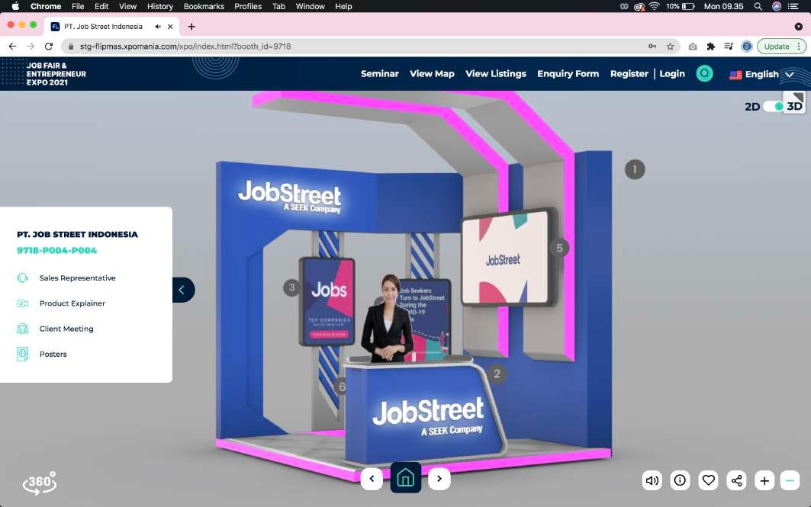
Visitors can access poster and video content by pressing the hotspot button
09
the numbers are on the booth or the buttons or navbar at the bottom on the mobile. You can also mark your favorite booth by pressing the button
but you have to login as a visitor first.
Mobile - Navigasi 2D Booth
Desktop - Navigasi 3D Booth

Slide 11
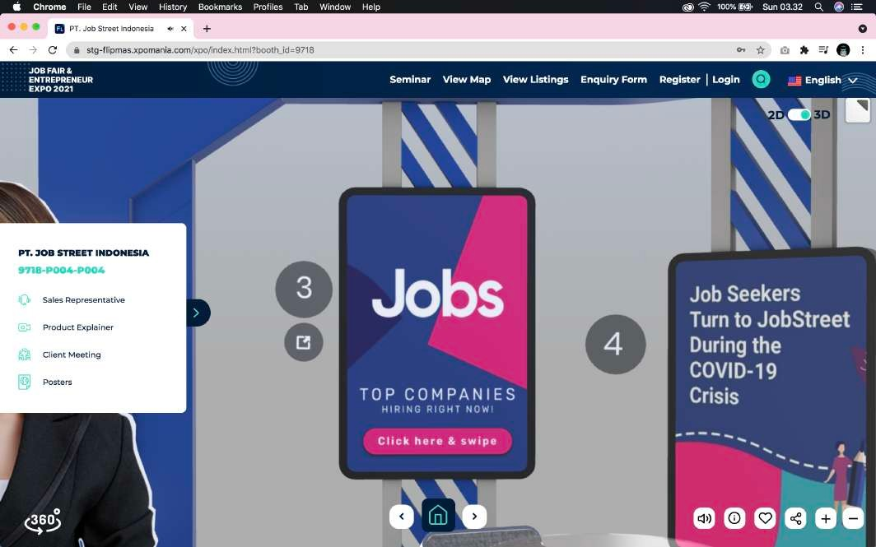
10
In 3D booth mode, you can see the poster slide on the poster with the click of a button
Mobile - Poster
Desktop - Poster Slide

Slide 12
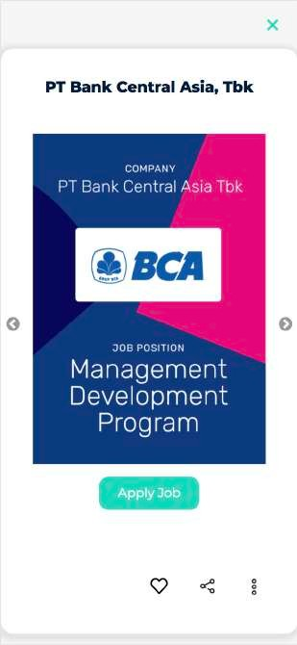
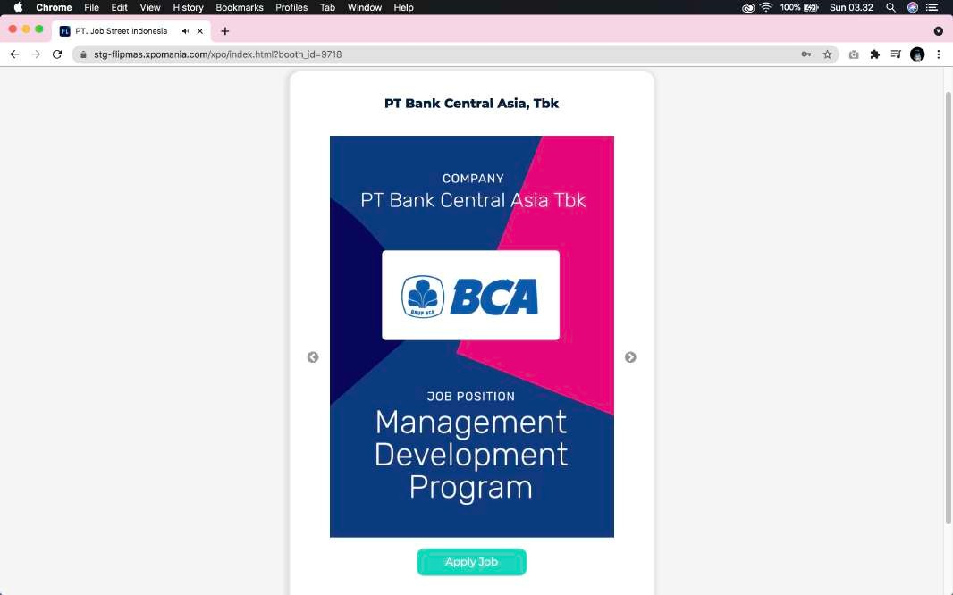
Especially for the jobfair zone, you can directly click "Apply Job" to send your application & CV where each company uses its own external recruitment website or uses the job application system from XPOmania.
11
Mobile - Apply Job
Desktop - Apply Job

Slide 13
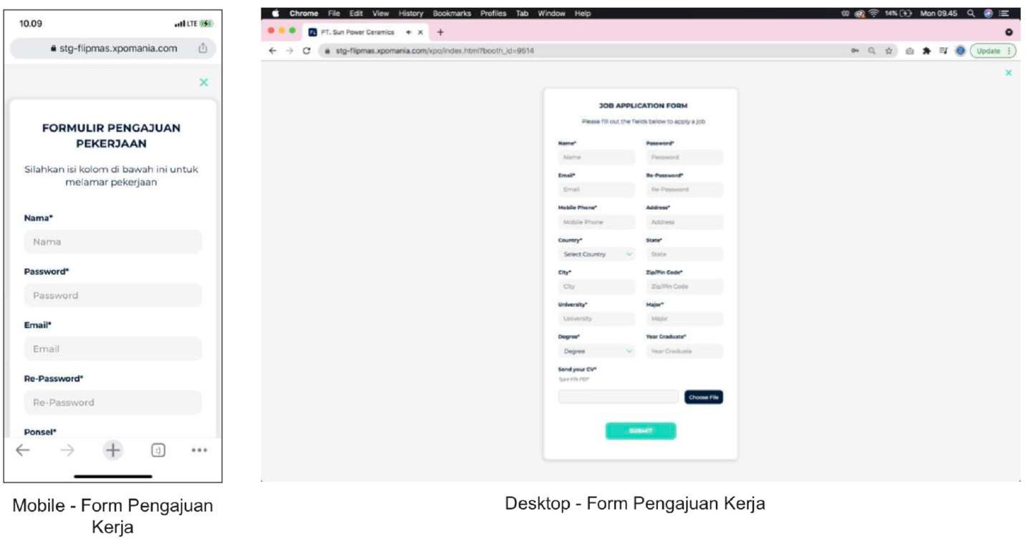
12
For JobFair Zone, You can send job applications directly to the company
by clicking the menu, you are welcome to register as a job applicant by filling out a job application form and attaching your application file in PDF form which usually consists of a Cover Letter and CV in 1 PDF file.

Slide 14
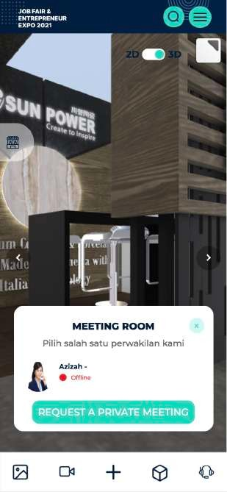
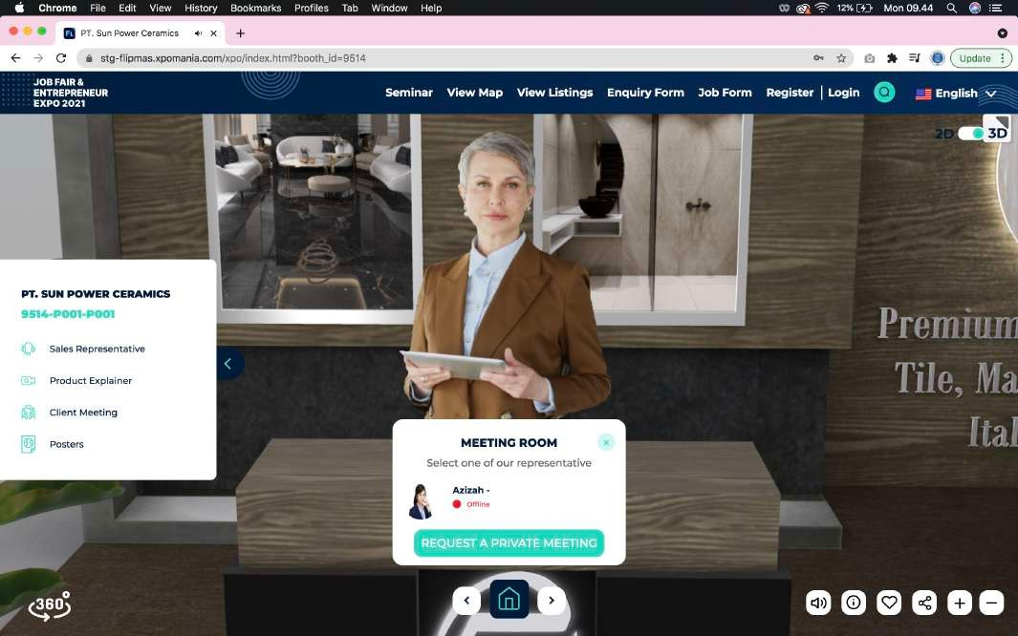
13
Especially for the Jobfair zone, you can use the video meeting room feature if the receptionist at the booth you are visiting is online.
Mobile - Meeting Room
Desktop - Meeting Room

Slide 15
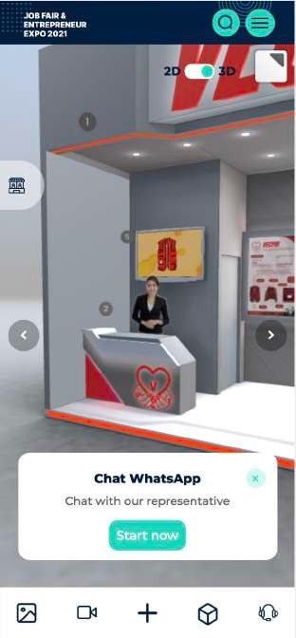
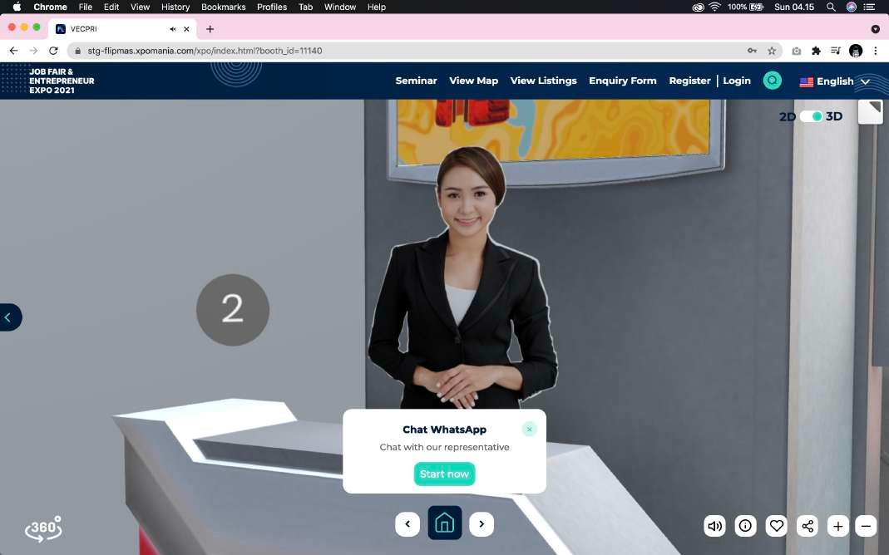
14
In the Flipmas & MSME, Education & Entrepreneur zone, you can use the Whatsapp Chat feature if the receptionist at the booth you visit is online.
Mobile - Chat Whatsapp
Desktop - Chat Whatsapp

Slide 16
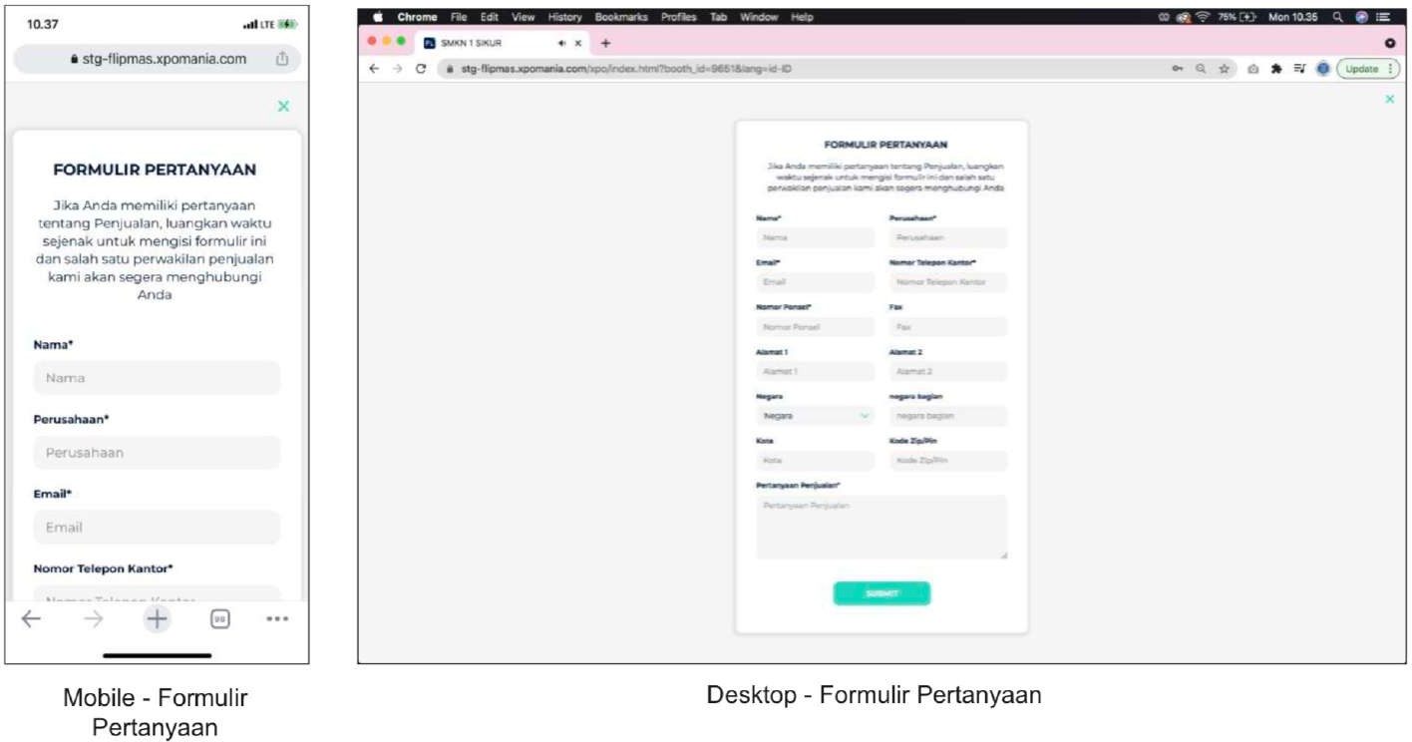
15
You can send an inquiry form which will be immediately received by the booth owner by clicking the "Form" menu button located in the menu header. This form can be used for the purpose of asking for information about products/services or how to order and so on to the booth owner.
Mobile - Inquiry form
Mobile - Inquiry form

